Slide 1


Project Management Operations
MSPM1-GC2030
MSPM1-GC2030
Session Number 4
Project Work Plan Part 2: Scheduling

Slide 2

Agenda
Scheduling
Network Diagram
Estimating Resources
Critical Path
HBS Game Simulation

Slide 3
Understanding schedule management
MSPM1-GC2030
Decompose the scope into a WBS
Determine resource skills
Estimate labor utilization, i.e., hours
Develop a network diagram
Create a Gantt chart
Track plan vs. actual
Measure schedule variances, i.e., SV, SPI
3

Slide 4
High-Level Scheduling
MSPM1-GC2030
Define Activities
Sequence activities
Estimate Activity Resources
Estimate Activity Durations
Develop Schedule
Control Schedule
4

Slide 5
High-Level Scheduling
MSPM1-GC2030
Define Activities
Sequence activities
Estimate Activity Resources
Estimate Activity Durations
Develop Schedule
Control Schedule
5

Slide 6
What You Need to Define Activities
MSPM1-GC2030
Organizational Process Assets
Lessons learned from prior projects
Enterprise Environmental Factors
Project management system
Other factors
WBS
6

Slide 7
How to Define Activities
MSPM1-GC2030
Prior plans
Decomposing WBS work packages
Expert Counsel
Plan in Phases
Plan what you know now, leave the rest at milestones
7

Slide 8
Define Activities Output
MSPM1-GC2030
Activity List
Activity Attributes
Milestone Lists
8

Slide 9
Define Activities Output
MSPM1-GC2030
Activity List
Activity Attributes
Milestone Lists
9

Slide 10
Sequence Activities
MSPM1-GC2030
Put the list of activities in order!
10

Slide 11
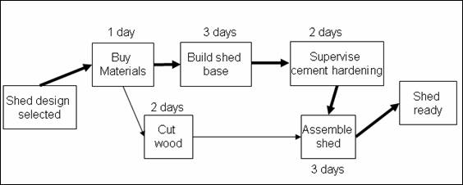
Network Diagram
Use a network diagram to visualize the way activities relate.
MSPM1-GC2030
11
www.projectminds.com

Slide 12
Network Diagram Terminology
MSPM1-GC2030
Project Network Diagram: Any schematic display of the logical relationship between project activities.
Path: A sequential order of activities defined by the project network logic.
Event: When an activity is either completed or started.
Node: a junction point joined to some or all of the other dependency lines (paths).

Slide 13
Make a Network Diagram!
MSPM1-GC2030
Name | Predecessor
Start | -
A | Start
B | A
C | B
D | Start
E | D
F | B
G | C
H | D
I | E, H
Finish | F, G, I

Slide 14
Scheduling Terminology
MSPM1-GC2030
Predecessors: Those activities that must be completed before initiation of a later activity in the network.
Successors: Activities that cannot be started until previous activities have been completed. These activities follow predecessor tasks.

Slide 15
Using Predecessors
MSPM1-GC2030
Finish to Start (FS)
Start to Start (SS)
Finish to Finish (FF)
Project planning software with predecessors
Can auto update when dates change
Robust and logical

Slide 16
Leads and Lags
MSPM1-GC2030
Lead time - when you give a successor task some time to start before the predecessor finishes.
Lag time - when you put a delay between the predecessor task and the successor.

Slide 17
Estimating Resources
MSPM1-GC2030
Resource Calendars
Certain people, rooms, and other resources are only available at certain times.
Activity List
Activity Attributes (what will the resources going do?)

Slide 18
How to Estimate Resources
MSPM1-GC2030
Expert Judgement
Estimating Data
Alternatives Analysis
Project Management Software
Bottom-Up estimating
Parametric estimating

Slide 19
How to Estimate Activity Durations
MSPM1-GC2030
Expert Judgement
Analogous Estimating
Parametric Estimating (software/formula driven)
Three-Point Estimates
Realistic
Optimistic
Pessimistic
Reserve Analysis
Also known as ‘contingency’ or ‘buffer’ = Team
Management Reserve = Financial Controller

Slide 20
PERT (Project Evaluation Review Technique)
MSPM1-GC2030
(Optimistic Duration + 4(Most Likely Duration) + Pessimistic Duration
6

Slide 21
Critical Path
MSPM1-GC2030
Every network diagram has a critical path - which is the string of activities taking up the longest duration in the network diagram.
Critical Path is important because it tells you what absolutely has to be completed when. If these events do not finish at the prescribed time in the path, your project will not finish on time.
Project managers constantly monitor their critical path - especially when the project experiences delays.

Slide 22
Almost Finished: Estimate Activity Durations
MSPM1-GC2030
How long is this going to take us - based on who is available.
“Jack is on vacation for the month of August, so we can’t allocate the servers needed for the upgrade until he returns.”
It may only take 1 week to allocate the servers (effort), but the duration will be affected by Jack’s vacation.

Slide 23
Managing Schedule Variances:
MSPM1-GC2030
Methods to accelerate work -
Fast tracking: Concurrent/ Parallel activities
Crashing: Add a new crew to work; duplicate labor
What are other methods to remediate schedule variance?

Slide 24
Baseline:
MSPM1-GC2030
Snapshot of the plan as of the start date or revision date
Use the baseline to compare the plan to actual
Plan = The work that was planned to be done
Actual = The work that was actually done

Slide 25
Suggested Artifacts on YouTube
MSPM1-GC2030
Constraints, Baselines and Requirements:
https://www.youtube.com/watch?v=JtNq0AlxT10&list=PLbuA2svvSuTpAIHKqOWIAPabnGE75e1IR
WBS:
https://www.youtube.com/watch?v=SqcuLsyFr-o
Project Scheduling:
https://www.youtube.com/watch?v=Rq19ga0U_jQ
Work Packages:
https://www.youtube.com/watch?v=jh-3c6WBhBE
Monitoring and Controlling:
https://www.youtube.com/watch?v=Bo9lVmeU4MY
Sample Gantt Chart in Excel: Chris Croft
https://www.youtube.com/watch?v=dDetfOCCMQo
25

Slide 26
Case Studies in Schedule Management: Today’s reading Lessons Learned: Team Breakouts in-class exercise
MSPM1-GC2030
Team 1: Case 4.1: Material Delays
Team 2: Case 4.2: Union Strike in France
Team 3: Case 4.3: Scheduling Challenge
Team 4: Case 4.4: Different Time Zones
Team 5: Case 4.5: Critical Path Tasks
Team 6: Case 4.6: Estimating Tasks

Slide 27
Project Management Operations GC2030 Game Simulation:
Harvard business school publishing

Slide 28
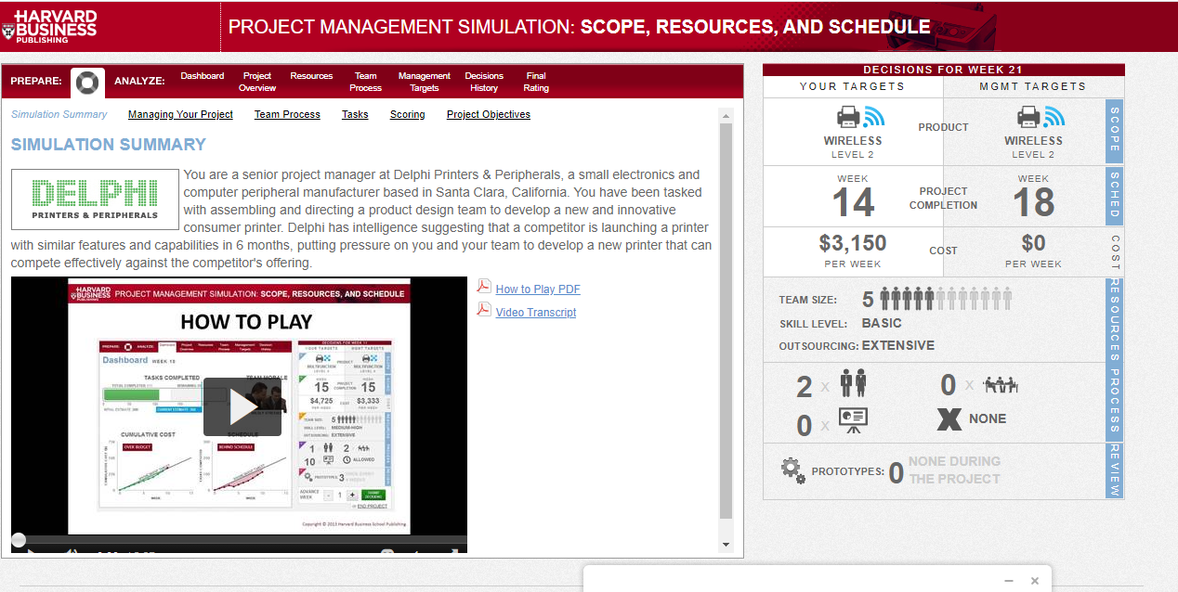
Run Summary– Game Simulation

Slide 29
Game Simulation:
Update:
Start by accessing the coursepack.
Accessing Course Material (a Coursepack) Assigned to You
PROJECT MANAGEMENT SIMULATION: SCOPE, RESOURCES, SCHEDULE V2
Click: https://hbsp.harvard.edu/import/802277 (Monday)
Click: https://hbsp.harvard.edu/import/802281 (Wednesday)
Play Scenario A
Get Site help at: https://help.hbsp.harvard.edu/hc/en-us
Objective: The learning outcome is the ability to understand the project constraints, adapt inputs to improve the project outcomes, and apply and interpret the EVM measurement framework to assess project performance.
Harvard Business School Publishing

Slide 30
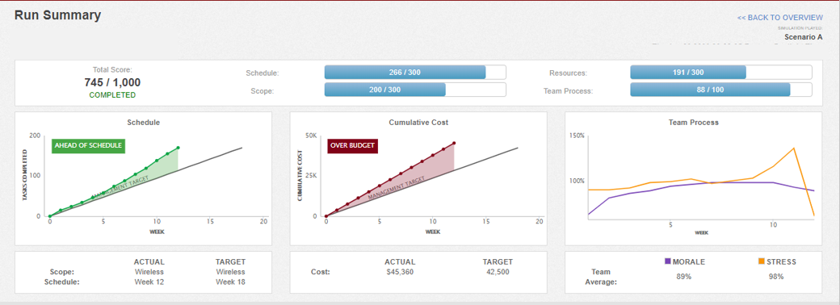
Run Summary– Game Simulation
The maximum number of points for meeting the targets is 700.
Additional points are awarded for exceeding the target.
Scope
Cost
Team Morale
Schedule
Schedule
Schedule
Harvard Business School Publishing

Slide 31

Session Recap

